Slide 1
Database
B+-tree

Slide 2
Outline
B+-tree
Query
Update
  Insertion
  Deletion

Slide 3
B⁺-Tree Index Files
B⁺-tree indices are an alternative to indexed-sequential files.
Disadvantage of indexed-sequential files: performance degrades as file grows, since many overflow blocks get created. Periodic reorganization of entire file is required.
Advantage of B⁺-tree index files: automatically reorganizes itself with small, local, changes, in the face of insertions and deletions. Reorganization of entire file is not required to maintain performance.

Slide 4
Range Searches
Find all students with gpa > 3.0’
  If records are sorted on gpa, do binary search to find first such student, then scan to find others.
  Cost of binary search can be quite high
Simple idea: Create an “index” file.
k1
k2
kN
Index File
Page 1
Page 2
Page 3
Page N
Data File

Slide 5
B+ Tree: Most Widely Used Index
General concept of a tree:
root
Level 1
Internal node
Level 2
Level 3
leaf
Level 4
Height of a node: its distance to the root
If a higher level node is connected to a lower level node, then the higher level node is called a parent (grandparent, ancestor, etc.) of the lower level node

Slide 6
B+ Tree (cont.)
Balanced tree: all leaves at the same level
  Example:
Structure of a B+ tree:
  It is balanced: all leaf nodes are at the same level
  Each node has a special structure

Slide 7
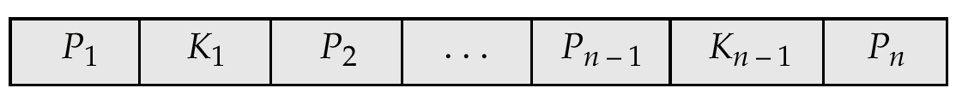
B⁺-Tree Node Structure
Typical node
  K_{i} are the search-key values
  P_{i} are pointers to children (for non-leaf nodes) or pointers to records or buckets of records (for leaf nodes).
The search-keys in a node are ordered
K₁ < K₂ < K₃ < . . . < K_{n–1}

Slide 8
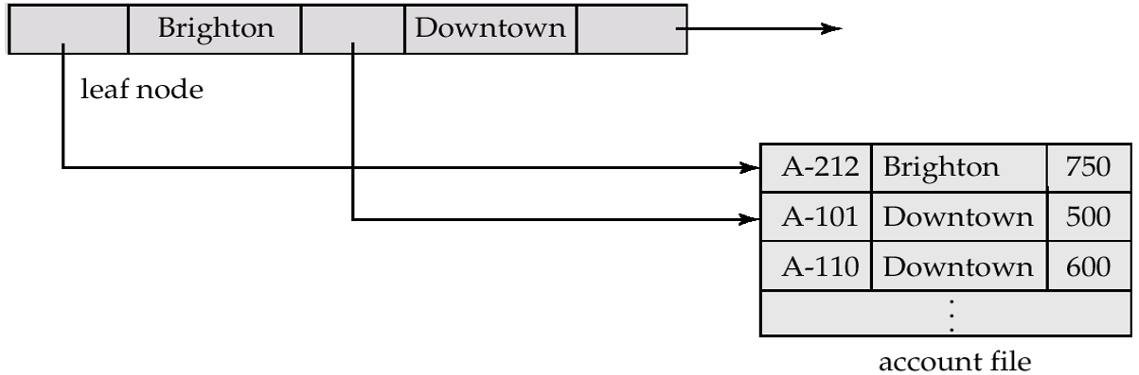
Leaf Nodes in B⁺-Trees
For i = 1, 2, . . ., n–1, pointer P_{i} either points to a file record with search-key value K_{i}, or to a bucket of pointers to file records, each record having search-key value K_{i}. Only need bucket structure if search-key does not form a primary key.
If L_{i}, L_{j} are leaf nodes and i < j, L_{i}’s search-key values are less than L_{j}’s search-key values
P_{n} points to next leaf node in search-key order

Slide 9
Non-Leaf Nodes in B⁺-Trees
Non leaf nodes form a multi-level sparse index on the leaf nodes. For a non-leaf node with m pointers:
  All the search-keys in the subtree to which P₁ points are less than K₁
  For 2 ≤ i ≤ n – 1, all the search-keys in the subtree to which P_{i} points have values greater than or equal to K_{i–1} and less than K_{i}

Slide 10

Example of a B⁺-tree
B⁺-tree for account file (n = 3, the max number of pointers in each node)

Slide 11
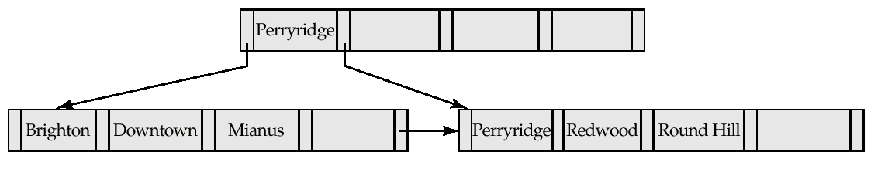
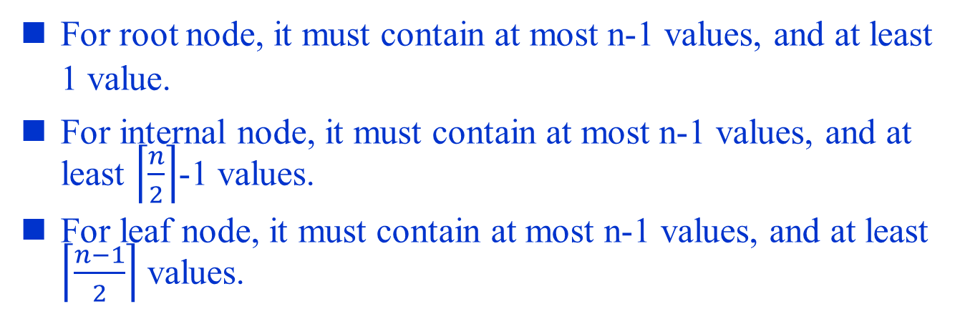
Example of B⁺-tree
B⁺-tree for account file (n = 5, the max number of pointers)

Slide 12
Example: A B+ tree
In this example, each node holds at least 1 entry, and at most 2 entries
Given search key value 27, how to find it?
  Search begins at the root, and key comparisons direct it to a leaf
  Note that key values are sorted at each level
Root
40
All keys < 40
All keys >= 40
20
33
51
63
Non-leaf
node
All keys < 20
10*
15*
20*
27*
33*
37*
40*
46*
51*
55*
63*
97*
Leaf node

Slide 13
Outline
B+-tree
Query
Update
  Insertion
  Deletion

Slide 14
Example: a B+ tree
Search for 5*, 15*, all data entries >= 24* ...
The last one is a range search, we need to do the sequential scan, starting from the first leaf containing a value >= 24.
>=24*
5*
Root
15*
13
17
24
30
2*
3*
5*
7*
14*
16*
19*
20*
22*
24*
27*
29*
33*
34*
38*
39*

Slide 15

Minimum height of the B+-tree
In general nodes are pages
Let H be the height of the B+ tree: need to read H+1 pages to reach a leaf node
Let F be the number of pointers in a node
  Level 1 = 1 page = F⁰ page
  Level 2 = F pages = F¹ pages
  Level 3 = Fx F pages = F² pages
  Level H+1 = …….. = F^{H} pages (i.e., leaf nodes)
  Suppose there are D data entries (values). So there are at least D/(F-1) leaf nodes
  D/(F-1) <= F^{H}. That is, H >= log_{F}( )
Height
0
1
level
1
2
Note that data entry is one less
than pointers

Slide 16
Cost of Searching a key
Usually, each node occupies a page
Cost of searching a key = H + 1 (pages)

Slide 17
Outline
B+-tree
Query
Update
  Insertion
  Deletion

Slide 18
Inserting a Data Entry into a B+ Tree
Find correct leaf L.
Put data entry onto L.
  If L has enough space, done!
  Else, must split L (into L and a new node L2)
    Redistribute entries evenly, put middle key in L2
    copy up middle key.
    Insert index entry pointing to L2 into parent of L.
This can happen recursively
  To split index node, redistribute entries evenly,
  but push up middle key. (Contrast with leaf splits.)
Splits “grow” tree; root split increases height.
  Tree growth: gets wider or one level taller at top.

Slide 19
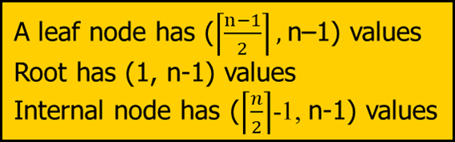
Example 1: Inserting 16*, 8* into Example B+ tree
Root
13
17
24
n=5
2*
3*
5*
7*
8*
14* 15
16*
You overflow
13
17
24
2*
3*
5*
7*
8*
One more child generated, must add one more pointer to its parent, thus one more key value as well.

Slide 20
Example 1: Inserting 16*, 8* into Example B+ tree
n=5
13
17
24
2*
3*
5*
7*
8*
5
13
17
24
2*
3*
5*
7*
8*

Slide 21
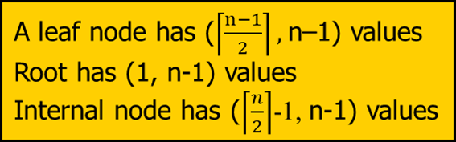
Example 2: Inserting 16*, 8* into Example B+ tree
Root
13
17
24
30
n=5
2*
3*
5*
7*
8*
14* 15
16*
You overflow
13
17
24
30
2*
3*
5*
7*
8*
One more child generated, must add one more pointer to its parent, thus one more key value as well.

Slide 22
Example 2: Inserting 16*, 8* into Example B+ tree
n=5
13
17
24
30
2*
3*
5*
7*
8*

Slide 23

Example 2: Inserting 16*, 8* into Example B+ tree
n=5
13
17
24
30
2*
3*
5*
7*
8*
You overflow
5
13
17
24
30
2*
3*
5*
7*
8*

Slide 24
Example 2: Inserting 16*, 8* into Example B+ tree
n=5
5
13
17
24
30
2*
3*
5*
7*
8*

Slide 25

Example 2: Inserting 16*, 8* into Example B+ tree
n=5
5
13
17
24
30
2*
3*
5*
7*
8*
5 13
17
24 30
2*
3*
5*
7*
8*

Slide 26

Example 2: Inserting 16*, 8* into Example B+ tree
n=5
Root
17
5 13
17
24 30
2*
3*
5*
7*
8*

Slide 27
Example 2: Inserting 16*, 8* into Example B+ tree
n=5
Root
17
5 13
24 30
2*
3*
5*
7*
8*

Slide 28
Outline
B+-tree
Query
Update
  Insertion
  Deletion

Slide 29
Deleting a Data Entry from a B+ Tree
Start at root, find leaf L where entry belongs.
Remove the entry.
  If L is at least half-full, done!
  If L has too few entries,
    Try to re-distribute, borrowing from sibling (adjacent node with same parent as L).
    If re-distribution fails, merge L and sibling.
If merge occurred, must delete entry (pointing to L or sibling) from parent of L.
Merge could propagate to root, decreasing height.

Slide 30
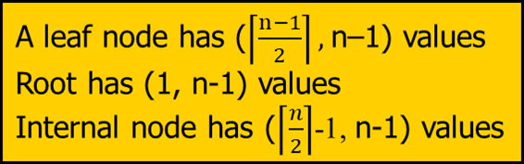
Ex1: Delete 19* and 20*
Root
n=5
17
5
13
24
30
40
2*
3*
5*
7*
8*
14*
16*
19*
20*
22*
24*
27*
29*
33*
34*
38*
39*
…
Underflow
22*
22* 24*
27* 29*
Have we still forgot something?

Slide 31
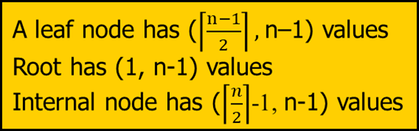
Ex1: Delete 19* and 20*
Root
n=5
17
5
13
27
30
40
2*
3*
5*
7*
8*
14*
16*
19*
20*
22*
24*
27*
29*
33*
34*
38*
39*
…
Underflow
22*
22* 24*
27* 29*

Slide 32

Ex2: Deleting 24*
Root
17
n=5
5
13
27
30
40
2*
3*
5*
7*
8*
14*
16*
22*
24*
27*
29*
33*
34*
38*
39*
…
We cannot borrow from the sibling node.

Slide 33
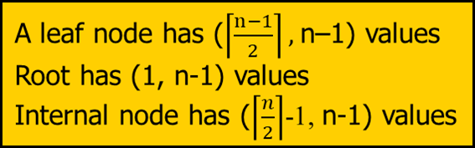
Root
17
n=5
5
13
27
30
40
2*
3*
5*
7*
8*
14*
16*
22*
27*
29*
33*
34*
38*
39*
…
Root
17
5
13
30
40
2*
3*
5*
7*
8*
14*
16*
22*
27* 29*
33*
34*
38*
39*
…

Slide 34

n=5
Root
17
5
13
30
40
2*
3*
5*
7*
8*
14*
16*
22*
27* 29*
33*
34*
38*
39*
…

Slide 35

Root
17
n=5
5
13
30
40
2*
3*
5*
7*
8*
14*
16*
22*
27* 29*
33*
34*
38*
39*
…
Root
17
5
13
30
40
2*
3*
5*
7*
8*
14*
16*
22*
27* 29*
33*
34*
38*
39*
…

Slide 36
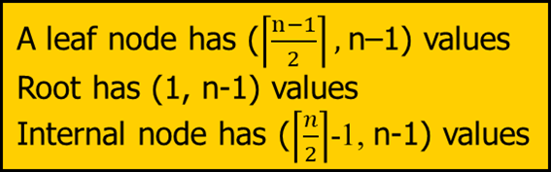
Ex3: Deleting 24*
Root
17
n=5
5
13
27
30
2*
3*
5*
7*
8*
14*
16*
22*
24*
27*
29*
33*
34*
38*
39*
We cannot borrow from the sibling node.

Slide 37
Root
17
n=5
5
13
27
30
2*
3*
5*
7*
8*
14*
16*
22*
27*
29*
33*
34*
38*
39*
Root
17
5
13
30
2*
3*
5*
7*
8*
14*
16*
22*
27* 29*
33*
34*
38*
39*

Slide 38
n=5
Root
17
Underflow
5
13
30
2*
3*
5*
7*
8*
14*
16*
22*
27* 29*
33*
34*
38*
39*

Slide 39
Root
17
n=5
5
13
30
2*
3*
5*
7*
8*
14*
16*
22*
27* 29*
33*
34*
38*
39*
Root
5
13
17
30
2*
3*
5*
7*
8*
14*
16*
22*
27* 29*
33*
34*
38*
39*

